Slide 1

Introduction into fMRI analysis. PsyMsc4 (Goethe 2021).
Session-2
Javier Ortiz-Tudela and Francesco Pupillo
1
Notes:
1

Slide 2
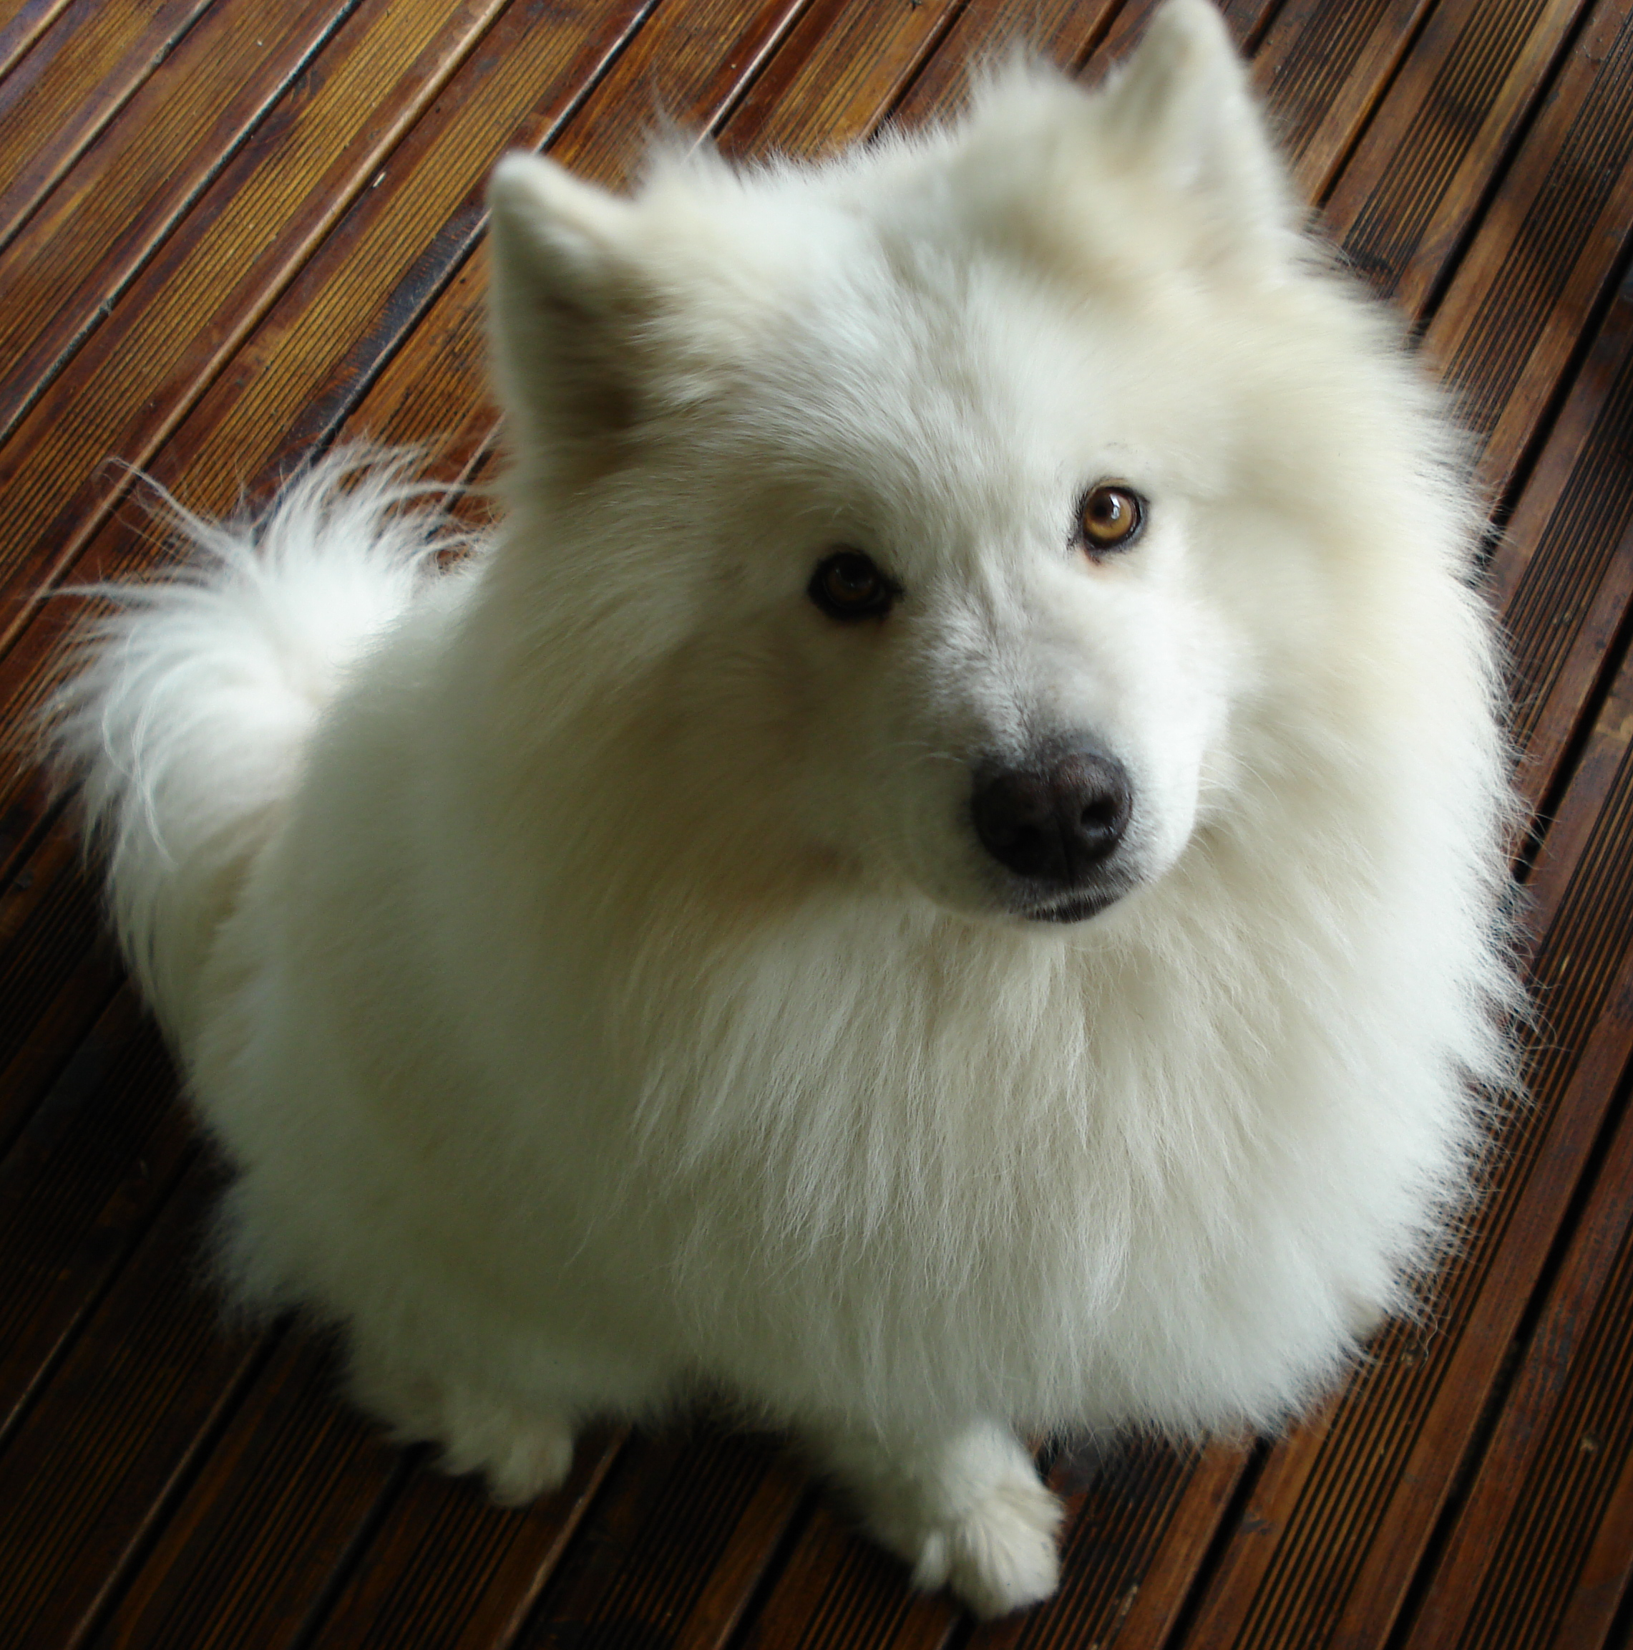

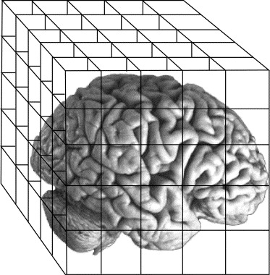
Recap of last week
MR basics:
- Scanner = magnet + RF transmitter
- MRI relies on the magnetic properties of the tissue.
- MR images are 3D “pictures” composed of voxels with one value per voxel.
- Most common 3D files: NifTi (.nii) and compressed NifTi (nii.gz).
- Spatial resolution depends on scanner strength.
QUESTIONS?
Type of images:
MR images can be roughly grouped into anatomical and functional images.
Anatomical images (usually one volume) have higher spatial resolution than functional images (usually several volumes).
TR = time to collect one brain volume.
Preprocessing:
- Slice-time correction
- Magnetic field distortions
- Intensity inhomogeneities
- Motion correction
- Registration
- Normalization
2
Notes:
2

Slide 3
Recap of last week
MR images are a collection of voxels (3D matrix) with a value (a number) in each cell.
The value represents a different thing for anatomical and functional images.
3
Notes:
3

Slide 4
Functional MRI. BOLD signal.
Functional images are used to study brain activity.
But what does brain activity look like when looked through a MR scanner?
4
Notes:
4

Slide 5
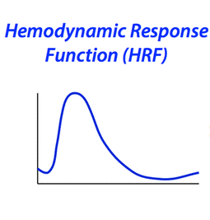
Functional MRI. BOLD signal.
Functional images are used to study brain activity.
What we are recording in our functional sequences is actually blood oxygen level dependent​ (BOLD) signal.
But what does brain activity (BOLD) look like when looked through a MR scanner?
5
Notes:
5

Slide 6
Functional MRI. BOLD signal.
Rise
Undershoot
Initial dip
0s
~15s
Recovery
6
Notes:
6

Slide 7
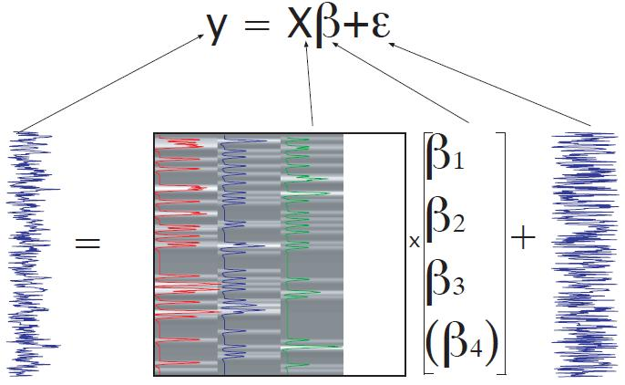
Functional MRI. BOLD signal.
This is the ‘ideal’ response to stimulation but, of course, the measured signal is noisier.
Measured signal in 1 voxel over many volumes
Time
7
Notes:
7

Slide 8
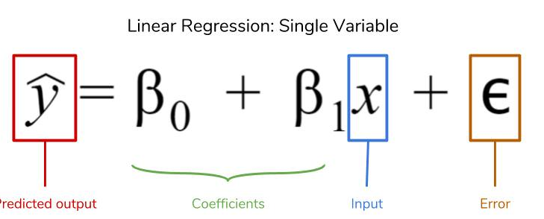
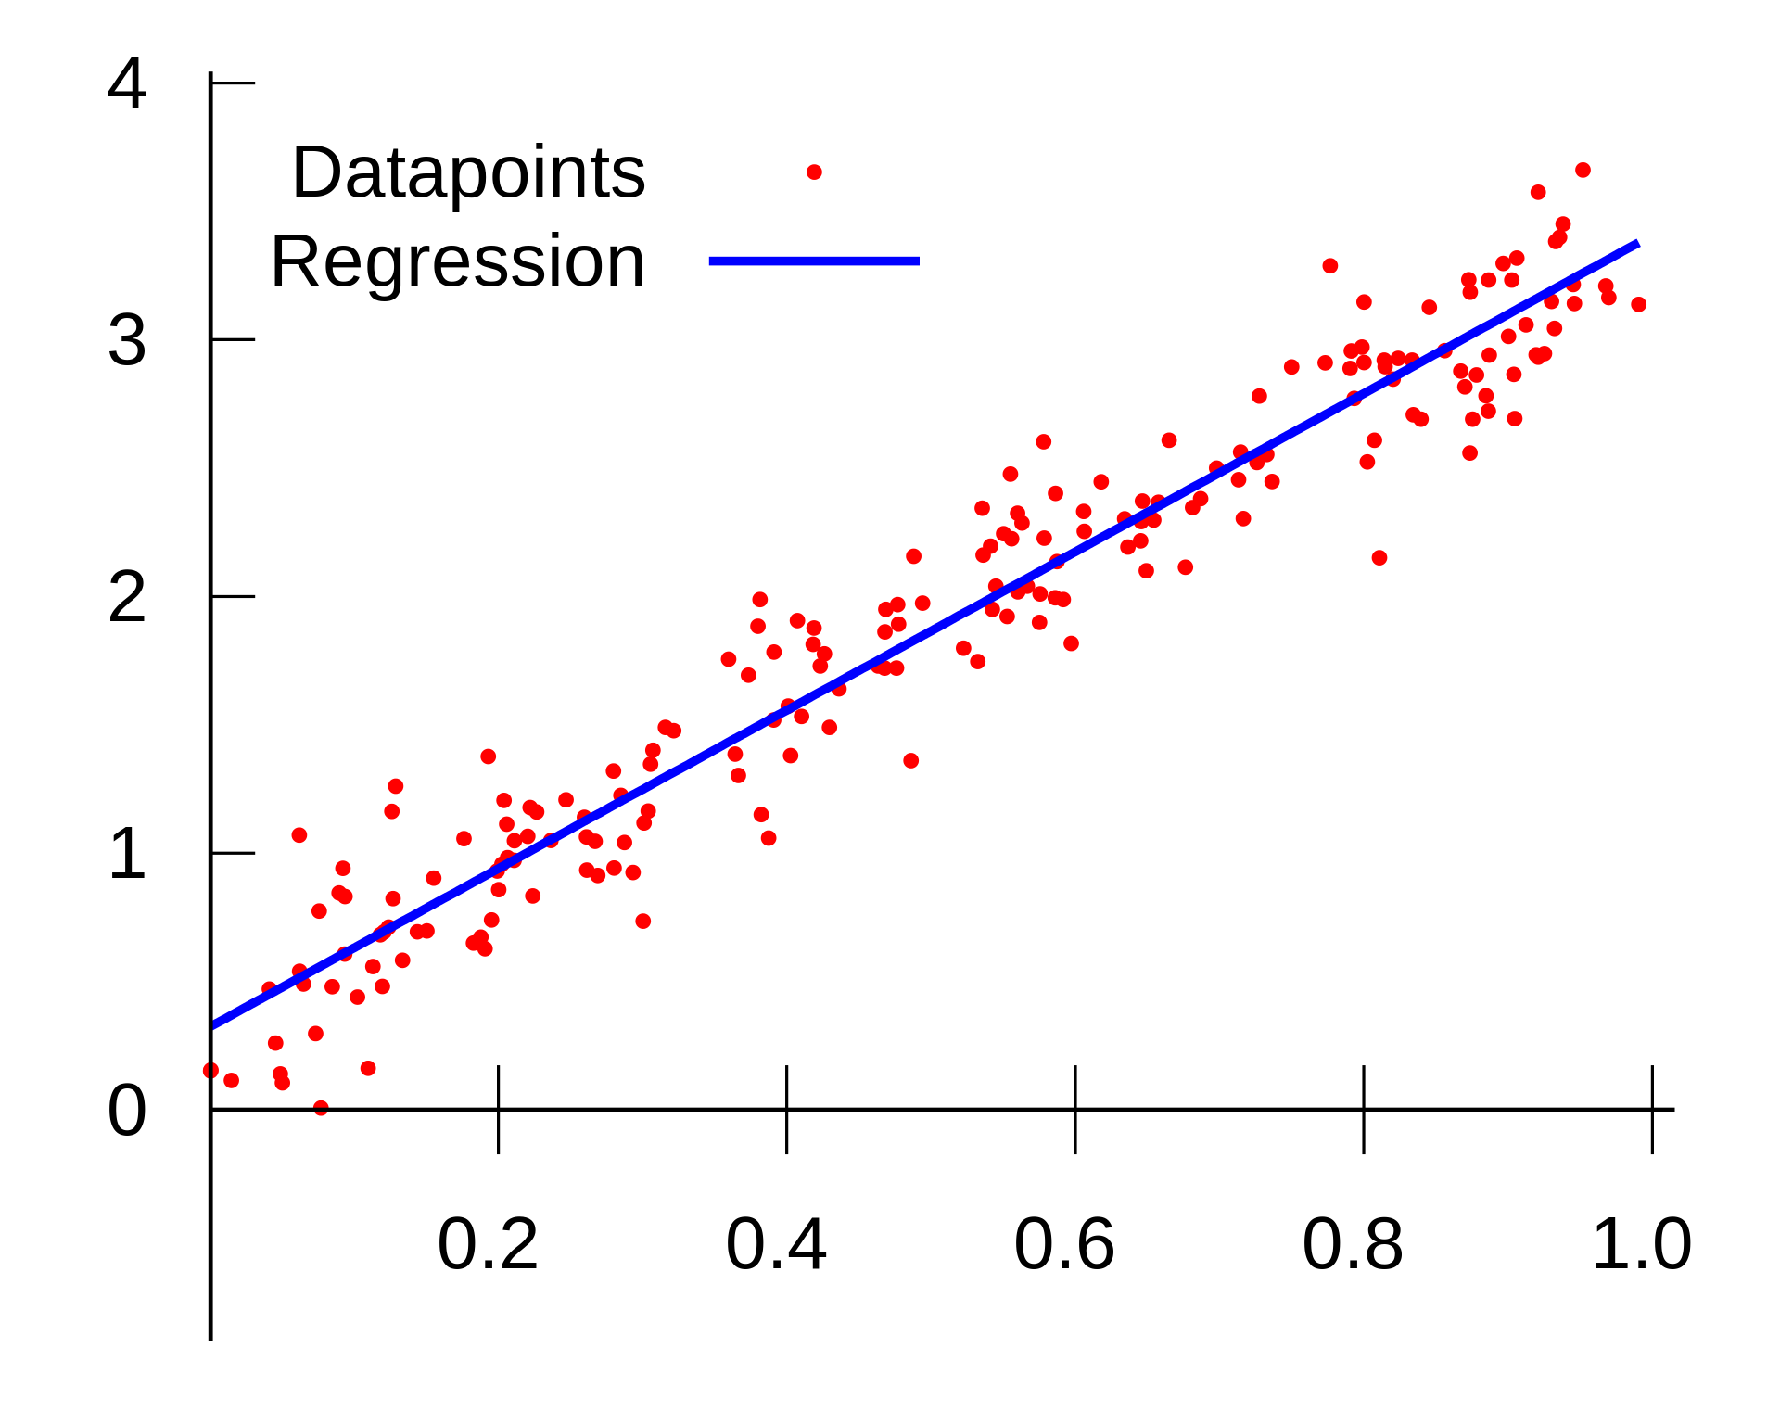
GLM. Generalized Linear Models
If you remember your stats class…
Intercept
Slope
from Wikipedia
8
Notes:
8

Slide 9
GLM. Generalized Linear Models
If you remember your stats class…
Intercept
Slope
QUESTION: What does the beta value represent?
from Wikipedia
9
Notes:
9

Slide 10
GLM. Generalized Linear Models
Regression is the usual approach for analysis of fMRI signals.
Measured signal in 1 voxel over many volumes
Time
10
Notes:
10

Slide 11

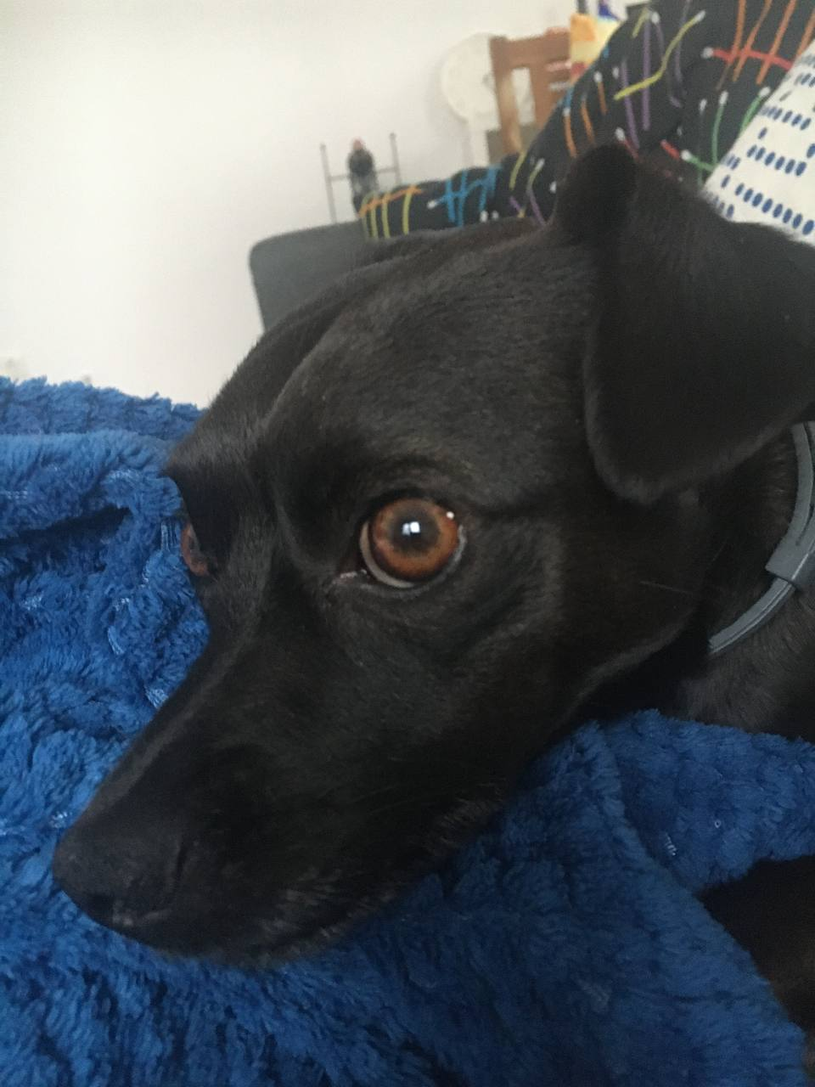
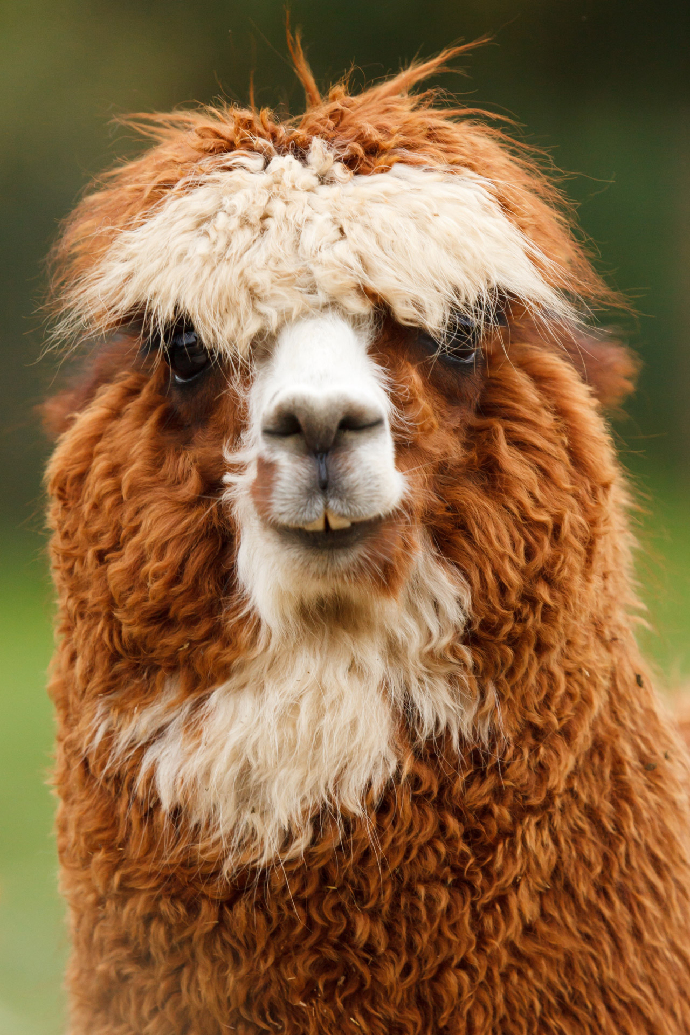
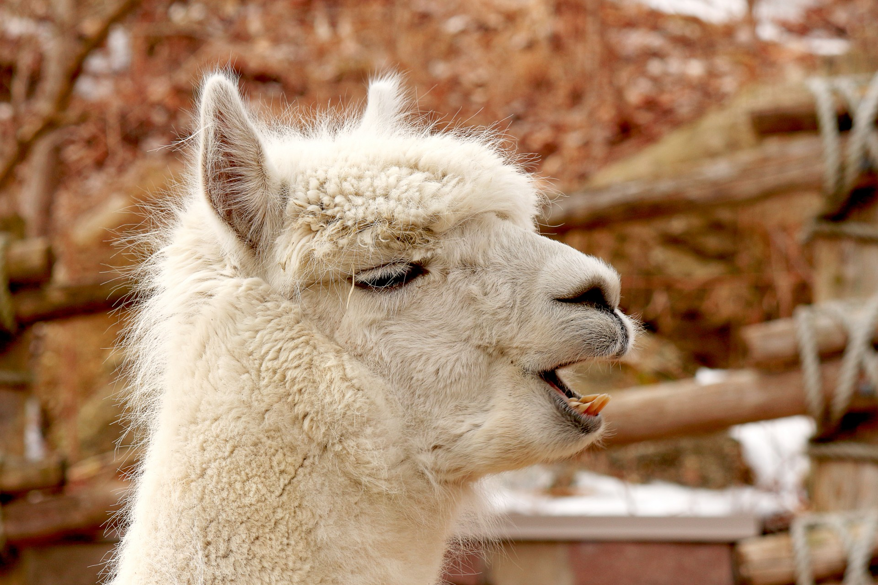
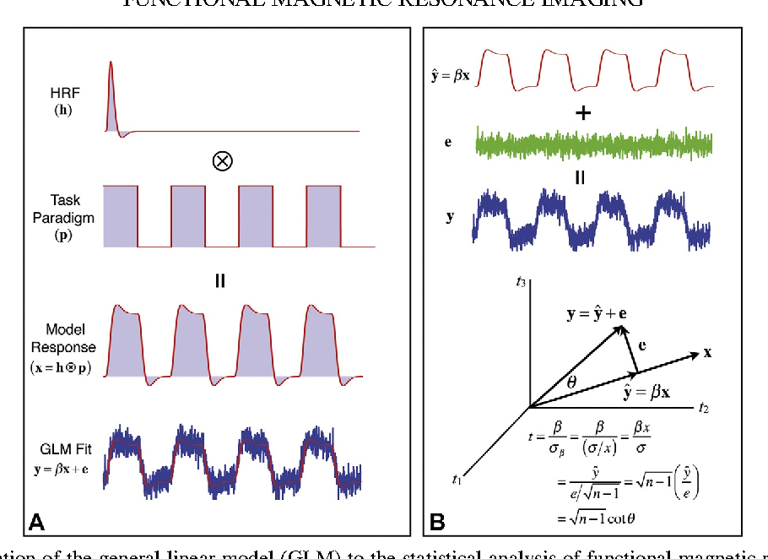
GLM
A practical example. Can we find voxels that respond to ANIMAL FACES?
Task
(visual stim.)
+
+
+
Voxel
activity
Time
Task
model
Present
Absent
Time

Slide 12
GLM
A practical example. Can we find voxels that respond to ANIMAL FACES?
Task
(visual stim.)
+
+
+
Voxel
activity
Time
Task
model
Present
Absent
Time

Slide 13
GLM
A practical example. Can we find voxels that respond to ANIMAL FACES?
Voxel
activity
Time
Task
model
Present
Absent
Time
Response
model

Slide 14
GLM
A practical example. Can we find voxels that respond to ANIMAL FACES?
Voxel
activity
Time
Now we can use regression to obtain an estimate (beta) of how much our response model explains our BOLD signal in our voxel.
Task
model
Present
Absent
Time
Response
model

Slide 15
GLM
A practical example. Can we find voxels that respond to ANIMAL FACES?
If run for every voxel, we will get one beta estimate per voxel, i.e., a beta map
Voxel
activity
Time
Task
model
Present
Absent
Time
Response
model

Slide 16
GLM
A practical example. Can we find voxels that respond to ANIMAL FACES?
QUESTION: What would the value in each voxel of the beta map represent?
Voxel
activity
Time
Task
model
Present
Absent
Time
Response
model

Slide 17
GLM
A practical example. Can we find voxels that distinguish to DOGS FACES from ALPACAS FACES?
Voxel
activity
Time
Task
model
Present
Regressor 1
Absent
Regressor 2
Time

Slide 18
GLM
A practical example. Can we find voxels that distinguish to DOGS FACES from ALPACAS FACES?
If run for every voxel, we will get one beta estimate per voxel, i.e., a beta map
Voxel
activity
Time
Task
model
Present
Absent
Time

Slide 19
GLM
A practical example. Can we find voxels that distinguish to DOGS FACES from ALPACAS FACES?
QUESTION: What would the value in each voxel of the beta map represent?
Voxel
activity
Time
Task
model
Present
Absent
Time

